Slide 1


BULK WORK ORDER CREATION - MAP
UtilizeCore
2022

Slide 2
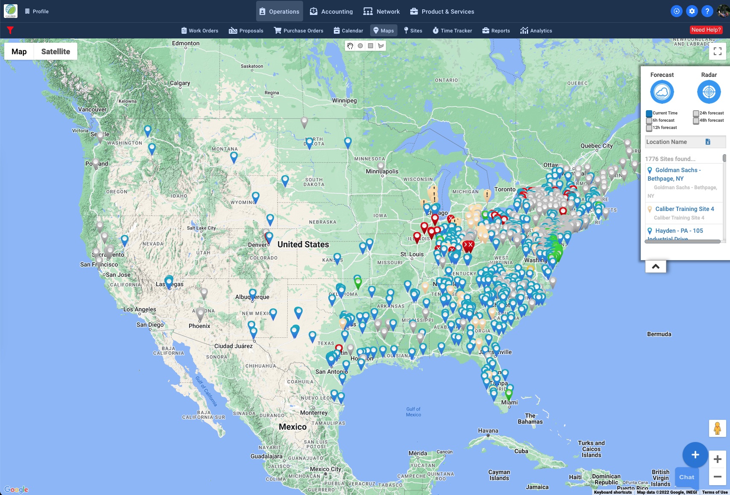
BULK WORK ORDER CREATION – Filtering & Selecting Sites
In the Operations menu, click Maps
On the Map screen, select Forecast or Radar depending whether you want to see precipitation or temperature.
Choose a filtering tool at the top and use the plus and minus in the bottom right to zoom in on the area you’re looking to select sites from.

Slide 3
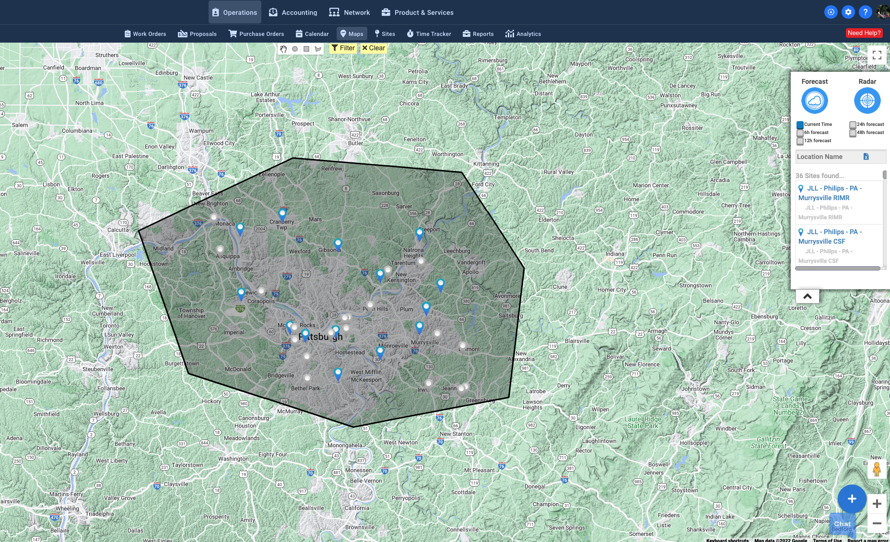
BULK WORK ORDER CREATION – Selecting Sites
Draw a shape around the sites you are looking to create work orders for and press the filter button at the top of the screen. This adds all the sites to the list on the right side of the screen under Location Name.
Click on the blue button with the plus sign in the bottom right corner to begin bulk creating work orders.

Slide 4
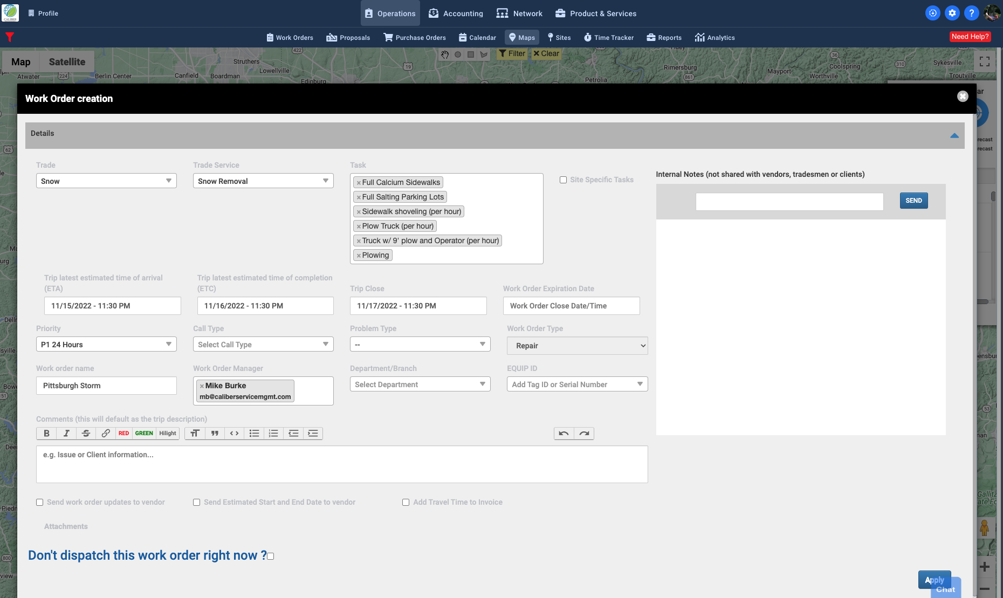
BULK WORK ORDER CREATION – Initial Work Order Configuration
Select the Trade
Select the Service
The tasks will populate, edit that list as needed
Set Trip ETA, Trip ETC, and Trip Close
Trip ETA – Estimated date when the vendor will Check In (a trip turns Red and is considered late if not checked in by this date
Trip ETC – Estimated date when the vendor will complete trip (status will also be Red if this date is missed)
Trip Close – After this date the Vendor can no longer check into or complete the trip
Choose a Priority (P1 – P5)
Enter a Work Order Name
Choose a Work Order Manager
Uncheck “Don’t dispatch this work order right now?”
Select Apply to create Work Orders

Slide 5
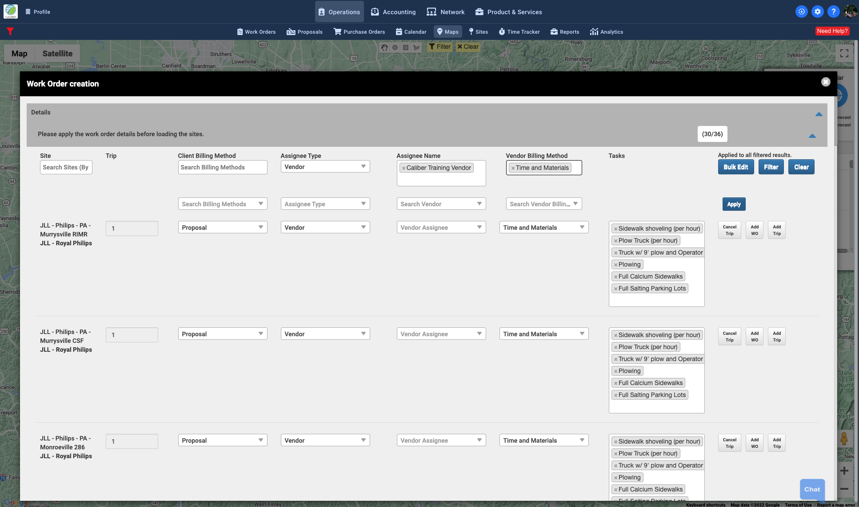
BULK WORK ORDER CREATION – Vendor and Billing Configuration
Scroll down to verify all sites were populated
Choose Client Billing Method
Choose Assignee Type – Vendor or Team Member
Assign Vendor or Team Member to each work order
Choose Vendor Billing Method (if needed)
Select Apply on the right side to apply choices to each Work Order

Slide 6
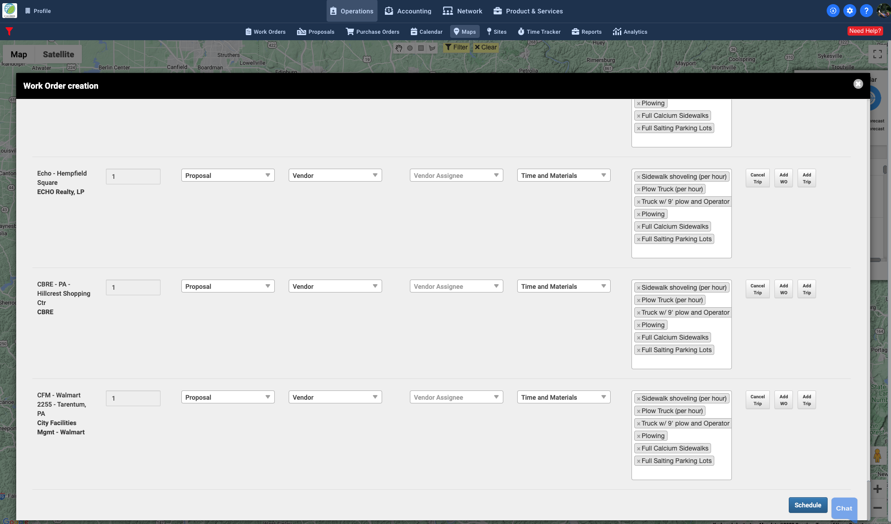
BULK WORK ORDER CREATION – Work Order Verification and Dispatch
Scroll down to verify all Work Orders have been configured properly
Click ”Schedule” to create and dispatch Work Orders.

